Slide 1
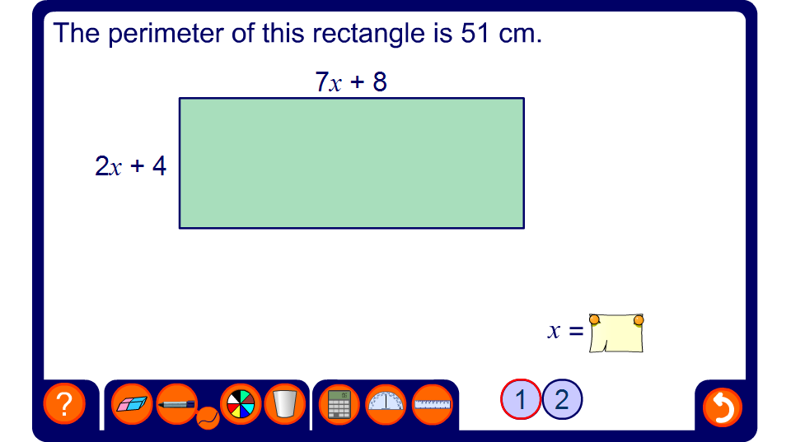


Find the value of x
Notes:
Discuss the equation that need to be written to find x.
Write this equation on the board using the pen tool and ask a volunteer to solve it.
Chose level 2 to give the perimeter in term of x.
Reveal the solution and ask pupils to use it to find the actual width and height of the rectangle and so check that the solution is correct.

